Slide 1
Introduction to Simulation and Modeling

Slide 2
Problem Formulation
(Lecture 7)

Slide 3
Introduction
The first step in conducting a significant simulation project is to ensure that adequate attention has been directed toward understanding what is to be accomplished by performing the study.
These activities are known as the problem formulation process and consist of:
A formal problem statement
Orientation of the system
Establishment of specific project objectives

Slide 4
Formal Problem Statement
Provide both the practitioner and the potential audience with a clearly understandable high-level justification for the simulation.
Although each situation will be unique, problem statements commonly include text related to:
Increasing customer satisfaction
Increasing throughput
Reducing waste
Reducing work in progress

Slide 5
Increasing Customer Satisfaction
Increasing customer satisfaction is of fundamental interest in any system involving service operations.
This type of system typically includes waiting or processing queues.
Reductions in queue time usually result in increased customer satisfaction.
Customer satisfaction may also involve delivering products when promised.

Slide 6
Increasing Throughput
Increasing throughput involves the amount of products or number of jobs that can be processed over a given period of time.
This can involve the elimination or improvement of different process operations.
It can also include the identification and redesign of bottleneck processes.

Slide 7
Reducing Waste
Reducing waste results in reduced operating costs and increased net profits.
Waste can be reduced through reductions in spoilage and obsolescence.
Spoilage can involve processes that are time and temperature critical.
Obsolescence waste can result from an organization’s inability to bring its product to the market on time.

Slide 8
Reducing Work in Progress
Work in progress is work that requires further processing for completion.
Work in progress typically requires storage before the next process can be carried out.
Reducing work in progress reduces process costs associated with resource capacity and storage requirements
Reducing work in progress can decrease the space needed for manufacturing or distribution facilities.

Slide 9
Tools for Developing the Problem Statement
There are two common tools available to the practitioner for assisting with the problem statement.
These are not actually problem-solving tools but rather are problem identification tools
Fishbone chart
Pareto chart

Slide 10
Fishbone Chart
The Fishbone chart is also known as the cause-and-effect diagram, man–machine–material chart.
The purpose of this chart is to identify the cause of the problem or effect of interest.
The Fishbone chart looks similar to the bones of a fish.
The head of the fish is labelled with the problem or effect.
Each major bone coming out of the spine is a possible source or cause of the problem.

Slide 11
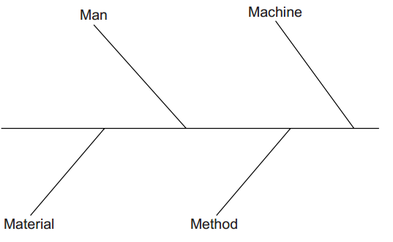
Fishbone Chart (Example)
For example, in a manufacturing process there are major bones for man, machine, material, and methods.

Slide 12
Fishbone Chart
Off each of the major bones, the practitioner is to add additional sub-bones. For the man bone, this might include supervisors, shift 1, shift 2, etc.
There is actually no limit to the number of sub-bones that can be created for a major bone or a sub-bone.
However, if the process is complicated enough, it might be necessary to change the level of the fish from the complete product or process to a more focused component or sub-process.
When the Fishbone diagram is complete, the practitioner can concentrate on the most important sources or causes of the problem or problems.
To assist the practitioner in this process, there is the Pareto chart.

Slide 13

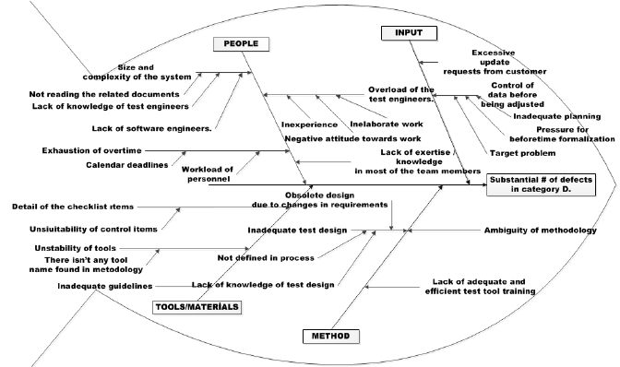

Slide 14
Pareto Chart
The Pareto chart is a second technique to help the practitioner to develop the problem statement.
It may turn out that there are several sources or causes of the problem or problems of interest.
The concept of the Pareto chart was developed by the Italian economist Wilfredo Pareto, who postulated that only a few factors are the cause of many problems.
This is frequently referred to as the 80–20 rule.
The 80–20 rule states 80% of the problem is caused by 20% of the factors

Slide 15
Pareto Chart
To implement a Pareto chart, you would need to know the number of defects from each source and the cost associated with the defect.
If these are multiplied together, the true cost of each defect can be determined. It is possible to end up with four general combinations of true costs:
Large number of inexpensive, easily repairable defects
Large number of expensive defects or a non-repairable product
Small number of inexpensive, easily repairable defects
Small number of expensive defects or a non-repairable product

Slide 16
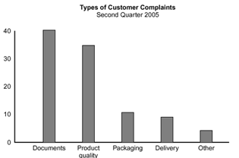
Pareto Chart

Slide 17
Orientation
Orientation is the second step in the problem formulation process.
Orientation involves the practitioner’s familiarizing himself or herself with the system.
In most cases the practitioner will not have the depth of knowledge of the managers, technicians, or workers who are involved in the process on a daily basis.
Even though the practitioner may have general familiarity with the system, it is unlikely that the practitioner is familiar with the system from a simulation viewpoint.
The practitioner must revisit the system keeping in mind how the system should be modelled and analysed with respect to the nuances associated with simulation modeling.

Slide 18
Orientation Process
The orientation process should consist of a minimum of three different types of orientation visits:
Initial orientation visit
Detailed flow orientation visit
Review orientation visit

Slide 19
1. Initial Orientation Visit
The purpose of the initial orientation visit is to obtain a high-level understanding of the basic inputs and outputs of the system.
The practitioner should identify particularly complicated components of the system.
In the first detailed flow orientation visit, the practitioner can request additional clarification on those components.

Slide 20
2. Detailed Flow Orientation Visit
it is time to gather detailed information on the operation of the system.
If the system is complicated or contains a number of components, the practitioner may need to conduct multiple visits.
The practitioner should make detailed notes on the system operation by recording:
  The types of entities that are processed by the system
  The number and type of queues
  The number and type of system resources
  The sequence of processes as experienced by the entities
  How the system performance can be measured

Slide 21
3. Review Orientation Visit
The purpose of this visit is to ensure that the understanding of the system operation is consistent with the practitioners’ understanding of the system and/or flow chart

Slide 22
Orientation Example

Slide 23
Orientation Example
Consider the relatively simple process of airline passengers.
We will assume that we have undertaken this process ourselves many times.
Given our familiarity with the general process, it will not be necessary to conduct an initial orientation visit.
In our subsequent detailed flow visits, we will need to observe the process from the standpoint of the passengers.
Close observation of this process will indicate that we will need to have knowledge of the following items:

Slide 24
Orientation Example
  The number of passengers on the plane
  The type of passenger: regular, family, handicapped
  The rate at which passengers travel down the aisle
  How far back the passenger must travel down the aisle
  Whether the passenger has an aisle, center, or window seat
  The percentage of passengers with carry-on bags
  The time it takes passengers to load each piece of luggage in the overhead bins

Slide 25
Orientation Example
It is obvious from this list of observations that the seemingly simple process of taking a seat in an aircraft suddenly becomes more complex when viewed from a simulation modeling standpoint
Note that we do not actually need to collect any of the data listed.
However, we do need to be aware of the fact that different types of data are associated with each of these processes.

Slide 26
Orientation Example
If we took our list of processes for a review orientation visit, we might discover that we had neglected to identify the following processes:
The number of times a passenger must get out of his or her seat to let other passengers by
How long it takes a passenger from an aisle or center seat to let the other passenger by
Whether the passenger must search the luggage compartments for space
How long it takes the passenger to search for the space and place the luggage.
Although it is not necessary to develop a flow chart of the process at this stage of the simulation study, there is little doubt that it would have been beneficial, even in this simple example.

Slide 27
Project Objectives
This is the final step in the problem statement process of the simulation study.
The project objectives should also be considered as dynamic.
During the course of the study, the practitioner may discover other information that may prove to be more profitable to pursue.

Slide 28
Examples of Project Objectives
Common project objectives may involve:
Performance-related operating policies
Performance-related resources policies
Cost-related resource policies
Equipment capabilities evaluation

Slide 29
Performance-Related Operating Policies
If the system is already in place, the practitioner may be interested in making the best use of the existing resources.
The analysis of different types of scheduling priorities falls in this category of project objectives.
The opposite objective approach could also be used for scheduling.
In this case, the practitioner could use a simulation model to establish how to quote system times or delivery dates.
    how long each type of job will take

Slide 30
Performance-Related Operating Policies
One of the most common types of objective is to try to determine the best alternative among many different queue configurations.
For example, banking facilities utilize both a number of different parallel queues that feed to a particular clerk and a single snake-type queue that feeds to a number of different clerks.
In addition, some banking facilities may include express lines in addition to the regular transaction lines.
So for a given level of resources, the objective is to determine the best queue configuration

Slide 31
Performance-Related Resource Policies
In this case, the focus is on determining the best performance among different resource level alternatives.
  These include retail stores, restaurants, and entertainment facilities.
  For example, if the wait time for a restaurant becomes excessive, customers will go elsewhere.
  The loss of goodwill can impact the restaurant not only at that time but also in the future.

Slide 32
Cost-Related Resource Policies
Many simulation project objectives focus on reducing costs while still maintaining a given level of performance
  How few resources are needed in order to keep the system performance at a given acceptable level
  E.g. passenger airlines industry

Slide 33
Equipment Capabilities Evaluation
To test or determine the capabilities of a proposed type of new equipment.
Without a simulation model of the new equipment, there is no way of determining if the equipment will actually function as claimed

Slide 34
Decision-Making Tools for Determining Project Objectives
When there is no clearly defined set of project objectives, the practitioner must develop a set of objectives that are satisfactory for both internal and external project stakeholders.
One common way of deciding on appropriate project objectives is to utilize engineering management decision-making tools.
These tools can include (Gibson et al., 2003):
  Brainstorming
  Nominal group technique
  Delphi process

Slide 35

1. Brainstorming
The idea behind brainstorming is to generate a storm of ideas that are created by being exposed to other ideas.
Discussion of other ideas gives birth to new ideas

Slide 36
1.1 Brainstorming Preparation
All of the participants to meet in one physical location.
The number of participants may be dependent on who is involved in the project.
    optimal number of participants in an activity of this sort is between 5 and 12.
The administrator must also have some sort of large-format recording medium that all of the participants can simultaneously see.
    whiteboard, an overhead, Electronic Whiteboard

Slide 37
1.2 Brainstorming Process
All of the participants gathered in one area such as a conference room.
The administrator will provide all of the participants with some sort of orientation describing the rules and purpose of the session.
At the end of the orientation, the administrator should explicitly solicit the participants for questions.
When the participants are ready to start, the administrator begins the process by listing one idea for the project objectives on the large-format medium.
The administrator would then go around to each member in the group to offer additional ideas for the project objectives.
At the end of the brainstorming phase of the session, there should be a storm of ideas for further processing.

Slide 38
2. Nominal Group Technique
Once the storm of ideas for the project objectives has been generated, it is the administrator’s job to determine the most important project objectives using the “nominal group technique.”
In this procedure all of the participants have the opportunity to vote on what they believe is the most important project objective.
Once the process is ready to start, the voters are asked to cast one vote per cycle for an individual project objective idea. This cycle repeats until all the votes are cast
At the end of the nominal group technique process, the administrator should compile the votes and identify the most popular project objective ideas.

Slide 39
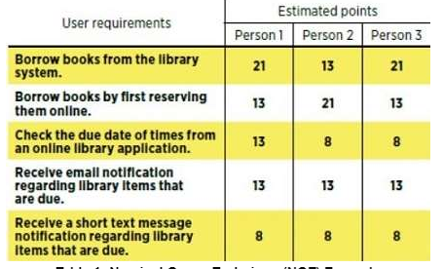
2. Nominal Group Technique

Slide 40
3. Delphi Process
In some organizations or situations undue political influence interferes with the selection of the project objectives.
This process serves the same function as the nominal group technique; however, all voting is conducted anonymously after the brainstorming session has concluded.
The process begins by having the administrator distribute a list of all of the brainstorming ideas.
The participants then cast one vote for a particular idea.
At the end of the first cycle, the administrator retains only a set of the most popular ideas.
The new set of ideas is redistributed to the group. This process continues until the set of project objective ideas is a suitable number.

Slide 41
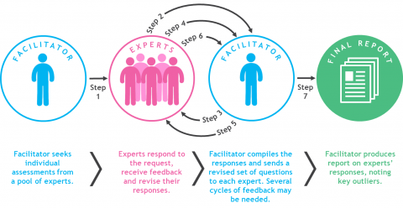
3. Delphi Process

Slide 42
Summary
Any Questions?

